Slide 1
Balanced Jump Model
Yuqi Nie (exchanged with Zihan Ding)
Princeton University

Slide 2
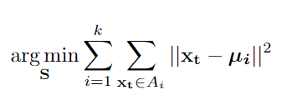
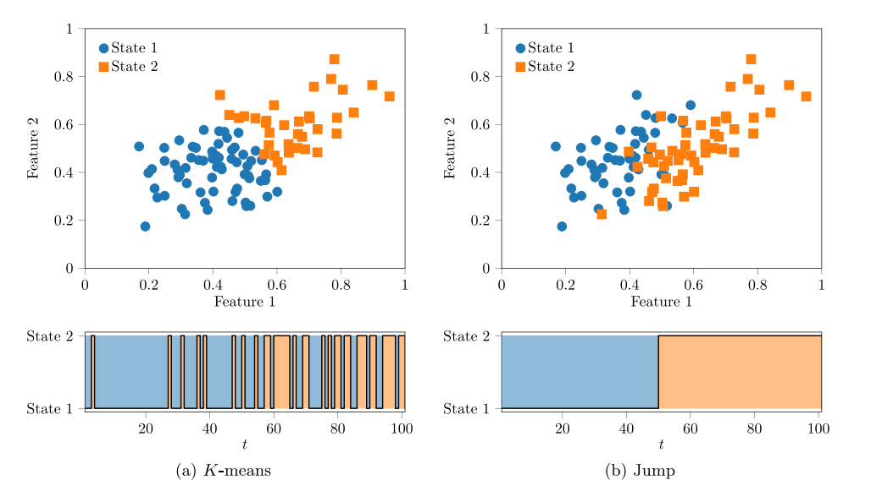
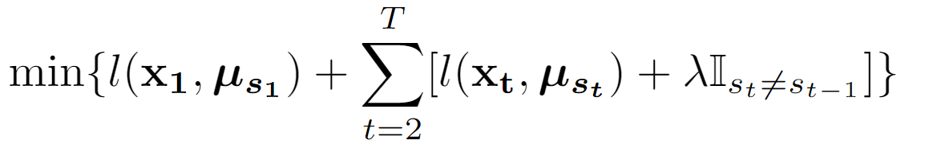

Jump Model
Penalize jumps in time series
Formula:
K-means:
Jump:
Petter N. Kolm, Peter Nystrup and Erik Lindström. Feature selection in jump models. Expert Systems with Applications, 184:115558, 2021.

Slide 3
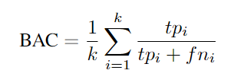
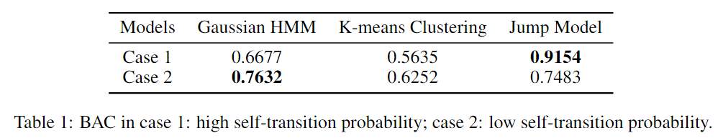
HMM or Jump?
Jump Model is more effective with high self-transition probability
Case 1: High self-transition probability
Case 2: Low self-transition probability
Balanced Accuracy:

Slide 4
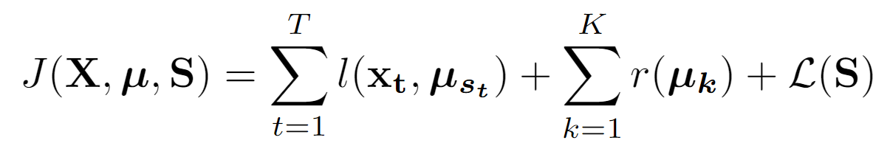
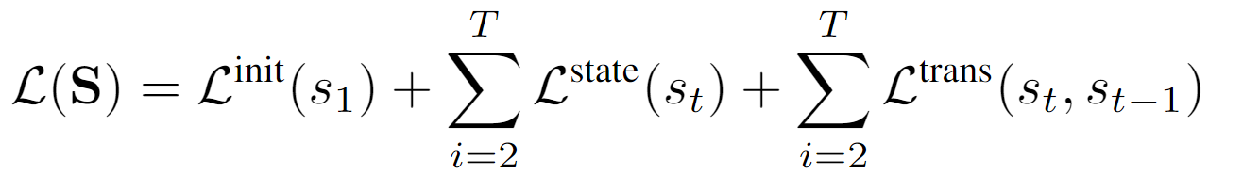
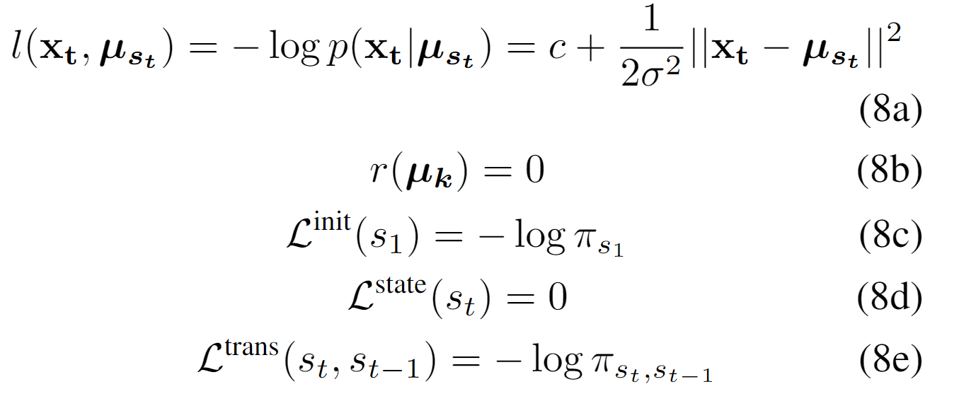
HMM as General Jump Model
General Jump Model:
(Gaussian) HMM:
Alberto Bemporad, Valentina Breschi, Dario Piga, and Stephen P. Boyd. Fitting jump models. Automatica, 96:11–21, 2018.

Slide 5
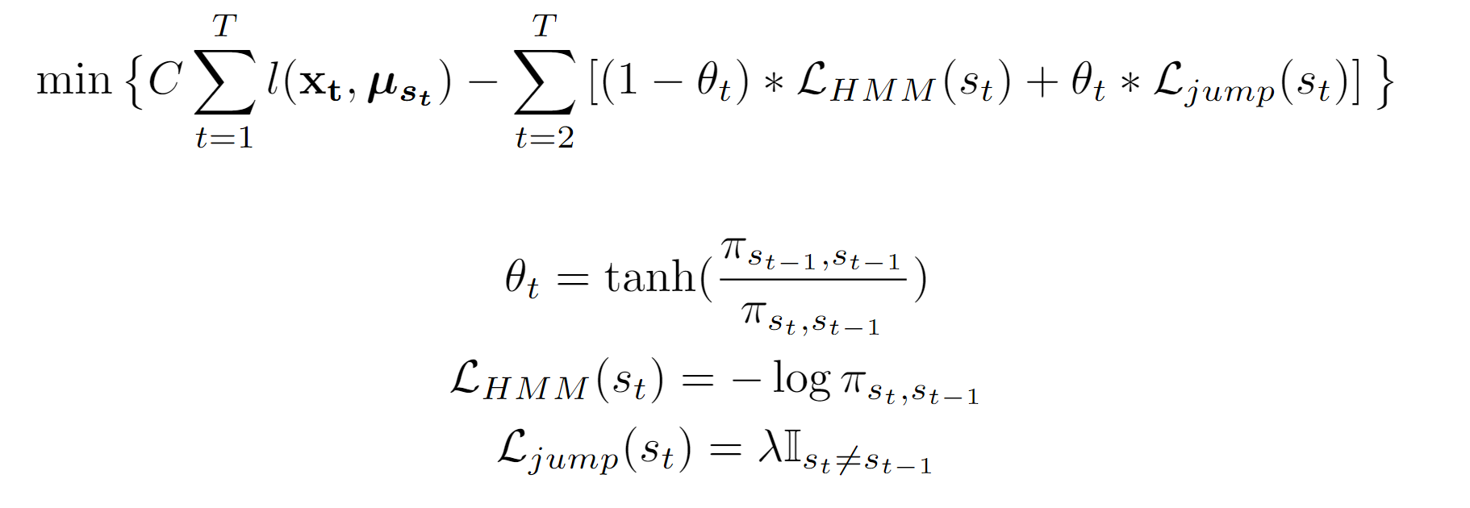
Balanced Jump Model
Balanced penalty between HMM and Jump Model
Penalty terms

Slide 6
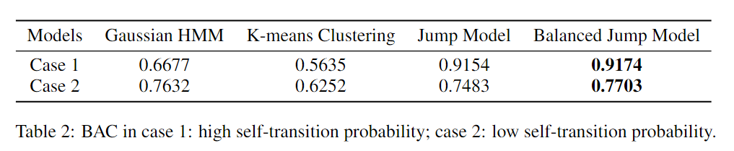
Results
Case 1: High self-transition probability
Case 2: Low self-transition probability

Slide 7
Conclusion
HMM can be expressed within the General Jump Model framework
A balanced penalty between HMM and Jump Model can improve the capability of generalization

